Slide 1


Slide 2
Table of contents
01
02
Team
Idea
03
04
Work stages
app

Slide 3
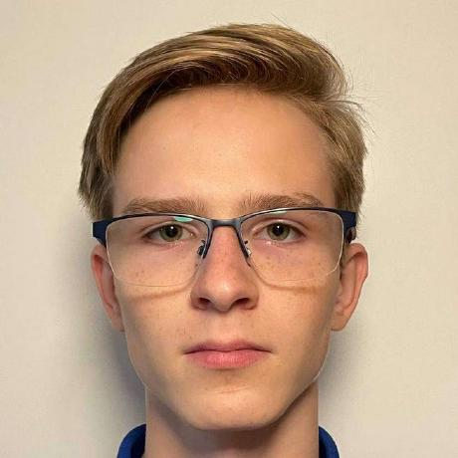
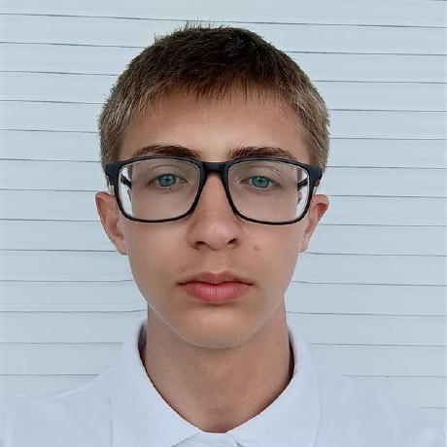
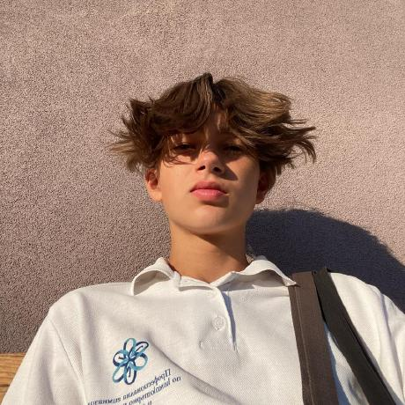
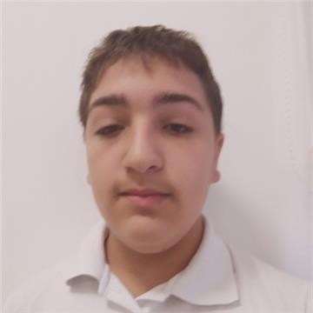
Team
Nikita Baladin
Backend developer
Ivan Beknev
Scrum Trainer
Simeon Syarov
Backend developer
Lev Davletov
Frontend developer

Slide 4
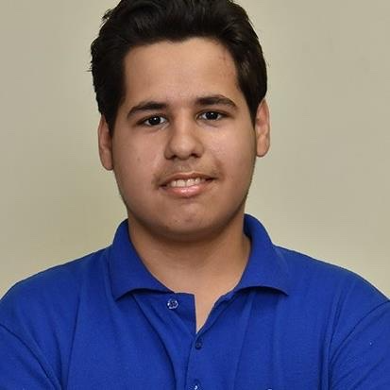
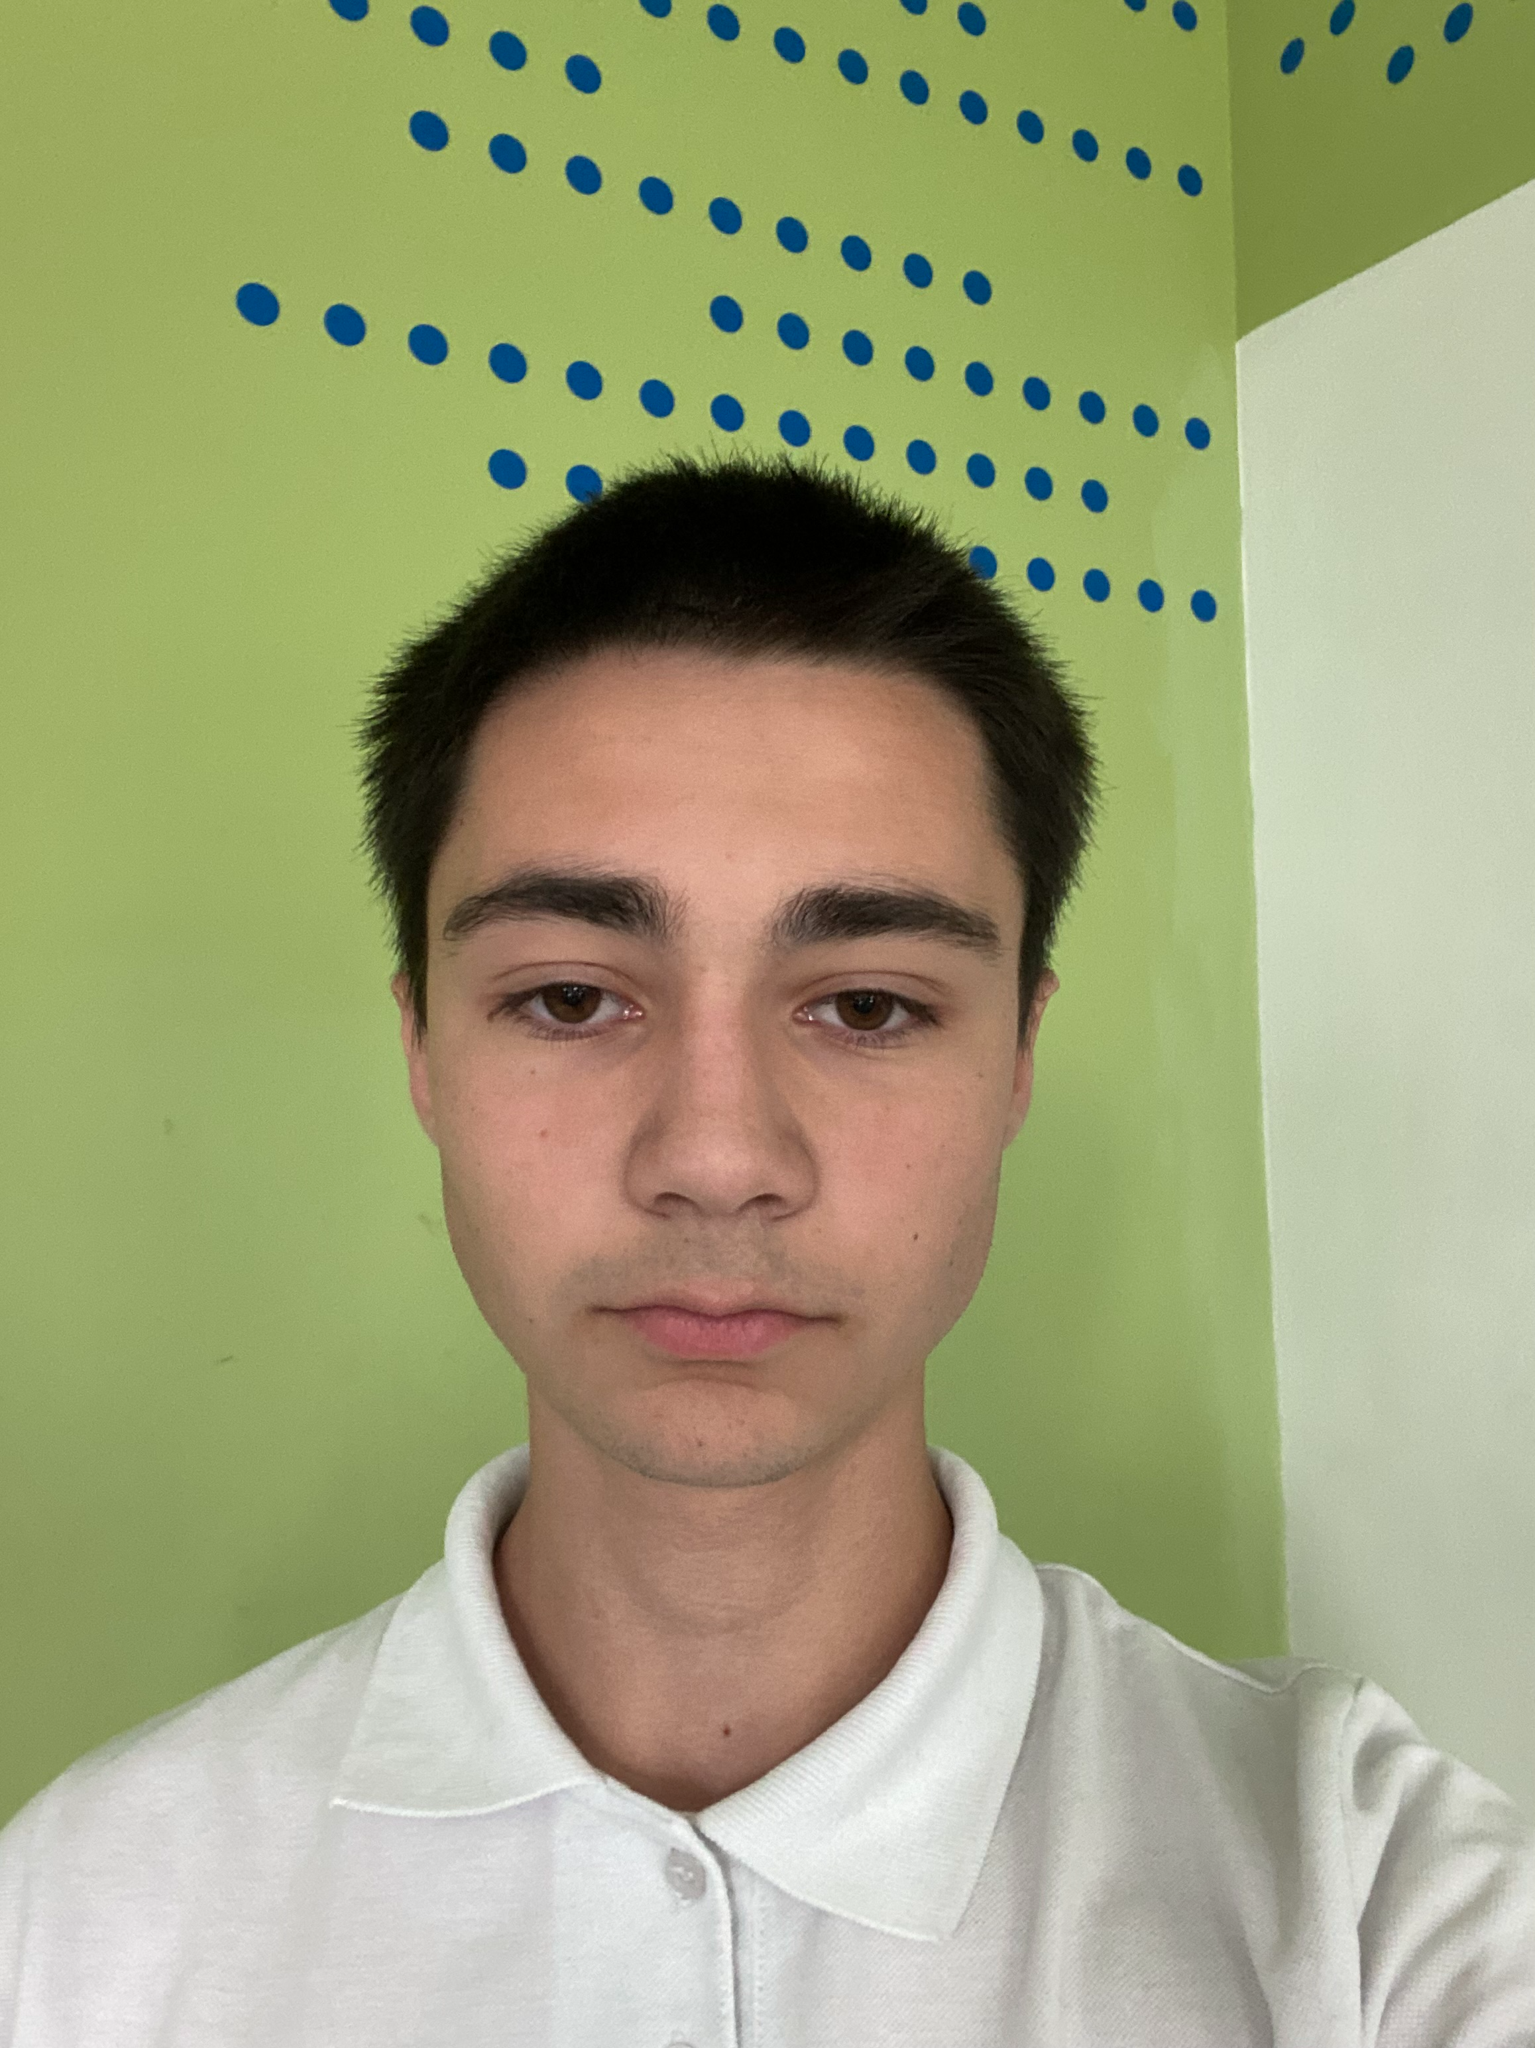
Team
Mihail Avagyan
Backend developer
Georgi Dimitrov
Backend developer

Slide 5
Work stages
Form a team
Develop an idea
Work on project
Finish the app
Project documentation
Rehearsal for the project presentation

Slide 6






Used technologies

